Slide 1
CHAPTER 1B
Threat Modeling
Secure Development Process
Threat Modeling
Risk Mitigation
Security Best Practices

Slide 2
What Is Threat Modeling?
Threat modeling is a procedure for optimizing computer and network security by identifying objectives and vulnerabilities, and then defining countermeasures to prevent, or mitigate the threats and their effects to a system in case of a cyber crisis or attack.
Threat modeling is also a security-based analysis process that:
  Helps a product team understand where the product is most vulnerable
  Evaluates the threats to an application
  Aims to reduce overall security risks
  Finds assets through asset management
  Uncovers vulnerabilities
  Identifies threats
  Should help form the basis of security design specifications

Slide 3
Threat modeling cont’d
Threat modeling is an analysis approach that helps designers to define the security aspect and areas of the design specifications.
The overriding driver of threat modeling is that you cannot build secure systems unless you understand your threats. The process aims to evaluate the threats to the application with the goal of reducing the consequences of an attack.
Threat modeling is simple although it does require significant time investment and some practice to get it right. However, time spent during this phase is time well invested. Bugs found during this phase of development are much cheaper to fix than bugs discovered right before shipping!
.

Slide 4
Threat modeling cont’d
Threat modeling has a structured approach that is far more cost efficient and effective than applying security features in a haphazard manner.
Without threat modeling, you may not know precisely what threats each feature is supposed to address. It leads naturally to a solid security design which is a part of the formal design specification of your application.

Slide 5
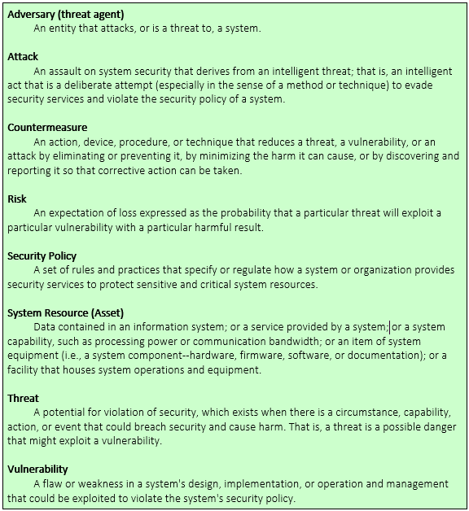
terminology

Slide 6
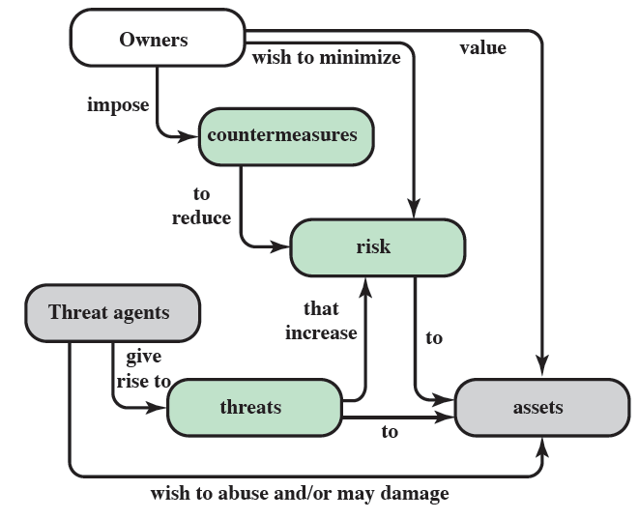
Security concepts and relationships

Slide 7
Threat consequences
Unauthorized disclosure: threat to confidentiality
  Exposure (release data), interception, inference, intrusion
Deception: threat to integrity
  Masquerade, falsification (alter data), repudiation
Disruption: threat to integrity and availability
  Incapacitation (destruction), corruption (backdoor logic), obstruction (infer with communication, overload a line)
Usurpation: threat to integrity
  Misappropriation (theft of service), misuse (hacker gaining unauthorized access)
Notes:
RFC 2828 describes four kinds of threat consequences and kinds of attacks that result:
Unauthorized disclosure is a threat to confidentiality:
Exposure: Sensitive data is directly released to an unauthorized entity.
Interception: An unauthorized entity directly accesses sensitive data in transit.
Inference: an unauthorized entity indirectly accesses sensitive data by reasoning from characteristics or byproducts of communications.
Intrusion: An unauthorized entity circumvents system's security protections.
Deception is a threat to either system integrity or data integrity:
Masquerade: An unauthorized entity poses as an authorized entity.
Falsification: False data deceives an authorized entity.
Repudiation: An entity deceives another by falsely denying responsibility for an act.
Disruption is a threat to availability or system integrity:
Incapacitation: Prevent/interrupt system operation by disabling a system component
Corruption: adversely modifying system functions or data
Obstruction: interrupts delivery of system services by hindering system operation.
Usurpation is a threat to system integrity:
Misappropriation: unauthorized logical or physical control of a system resource.
Misuse: Causes system to perform a function or service detrimental to security.

Slide 8
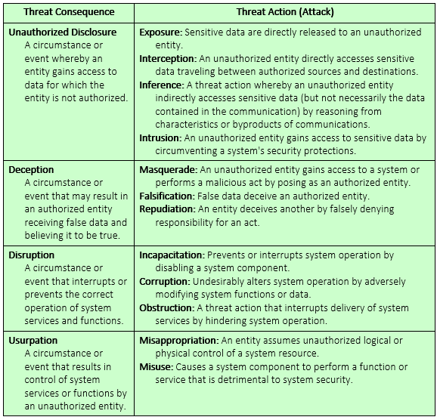
Threat consequences
(tabular form)

Slide 9
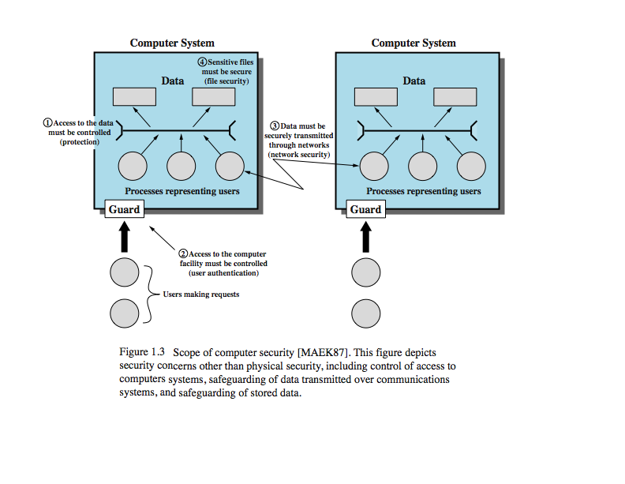
The scope of Threats to data and System security

Slide 10
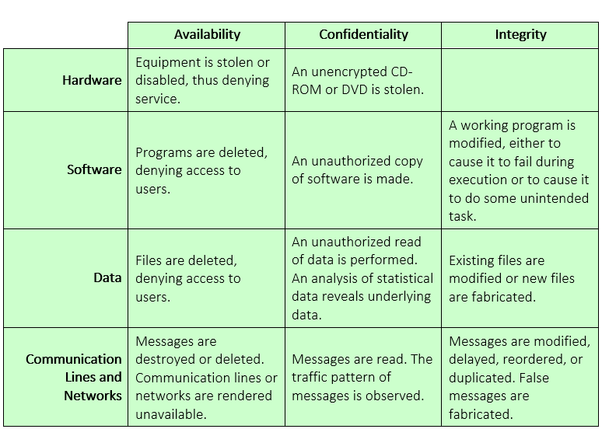
Examples of threats

Slide 11
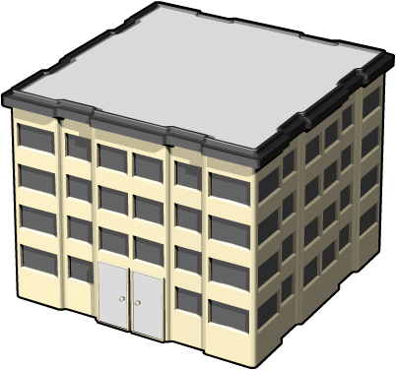
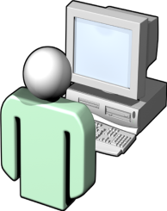
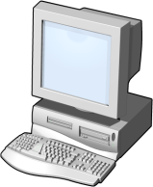

Benefits of Threat Modeling
Threat modeling allows you to systematically identify assets, vulnerabilities, threats and rate the threats that are most likely to affect your system which is termed as ASSET MANAGEMENT.
  An asset is also referred to in threat jargon as an attack target. It is anything that is worth protecting.
  A vulnerability is a weakness in a system, such as a bug or a design flaw.
  A threat to a system is a potential event
  that will have an unwelcome
  consequence if it becomes an attack
Vulnerability
Threat
Asset

Slide 12
Benefits of Threat Modeling contd
  Understand your application better: Team members specially the tech guys who make policies need to spend time analyzing the application in a structured manner and they end up inevitably with a deeper understanding of how the application works.
  Find bugs: The additional scrutiny of the threat modeling process leads to the discovery of other, non-security related bugs.
  Identify complex design bugs: The analytical nature of the process can reveal complex multi-step security bugs where several small failures combine to cause a major failure. This kind of vulnerability may be missed by unit testing performed by the developer and the majority of test plans.

Slide 13
Benefits of Threat Modeling contd
Threat modeling should drive your security test plan design. Testers should test against the threat model, which will help them develop new test tools and procedures.
  Integrate new members: Threat modeling is a useful tool for new team members to become familiar with the architecture of the product.
Threat modeling allows you to systematically identify assets, vulnerabilities, threats and rate the threats that are most likely to affect your system.
Threat modeling also helps provide a strict guideline for patch and update management
It can further assist set up policies in regards to User acess management

Slide 14
Benefits cont’d Security functional requirements
More benefits of threat modeling is coming up with a security functional requirements document which shall include
Technical measures
  Access control; identification & authentication; system & communication protection; system & information integrity
Management controls and procedures
  Awareness & training; audit & accountability; certification, accreditation, & security assessments; contingency planning; maintenance; physical & environmental protection; planning; personnel security; risk assessment; systems & services acquisition
Overlapping technical and management
  Configuration management; incident response; media protection

Slide 15
Threat Modeling Process
(Writing Secure Code + Threat Modeling)
Collect
Model the
Determine
Background
System
Threats
Information
Use Scenarios
Entry Points
External
Assets
Identify Threats
Dependencies
Implementation
Roles and
Identities
Assumptions
Analyze Threats
/
External Security
Trust Levels
Determine
Notes
Vulnerabilities
Data Flow
Internal Security
Diagrams
/
Process
Notes
Models

Slide 16
The Threat Modeling Process
Threat Modeling Process
1
Identify Assets
2
Create an Architecture Overview
3
Decompose the Application
4
Identify the Threats
5
Document the Threats
6
Rate the Threats

Slide 17
Threat Modeling Process – Step 1: Identify Assets
Build a list of assets that require protection, including:
  Confidential data, such as customer databases
  Web pages
  System availability
  Anything else that, if compromised, would prevent correct operation of your application

Slide 18
Identifying an Asset in a System
ENTRY POINTS
Services
  IIS, SQL, MSMQ, File, WS
Object or Classes
  DLLs, Tables, Views, etc
Methods
  Procedures, functions, Routines etc
ASSETS
Both concrete and abstract, that could be targets of an attack
  A concrete example might be corporate data stored in a database.
  A more abstract example might be network coherency in a peer to peer application.
Assets should be nouns.

Slide 19
Threat Modeling Process – Step 2: Create An Architecture Overview
Identify what the application does
Create an application architecture diagram
Identify the technologies
NTFS Permissions
(Authentication)
File Authorization
URL Authorization
.NET Roles
(Authentication)
User-Defined Role
(Authentication)
Trust Boundary
Trust Boundary
Alice
ASPNET
(Process Identity)
Mary
IIS
Microsoft
ASP.NET
Microsoft
SQL Server™
Bob
IPSec
(Private/Integrity)
SSL
(Privacy/Integrity)
Anonymous
Authentication
Forms
Authentication
Microsoft Windows
Authentication

Slide 20
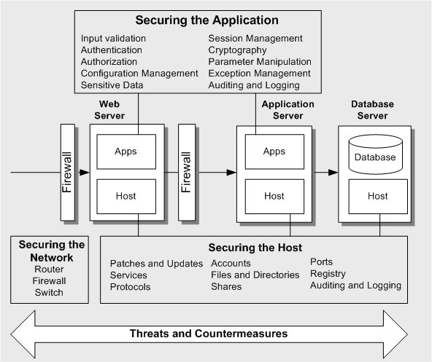

Architectual overview of the Threat Profile —Threats and Countermeasures

Slide 21
Create An Architecture Overview contd
The purpose of the architecture overview is to document the
  function of your application,
  its architecture and physical deployment configuration, and the technologies that form part of your solution.
There are three main parts to the application Architectural overview:
  Identify what the application does. Document use cases to help you and others understand how your application is supposed to be used. This also helps you determine how it can be misused. Use cases put application functionality in context.

Slide 22
Create An Architecture Overview contd
  Create an architecture diagram. This describes the composition and structure of your application and its subsystems as well as its physical deployment characteristics. Depending on the complexity of the application, this may need to split into several diagrams that focus on specific areas
  Identify the technologies. This helps you focus on technology-specific threats later in the process. It also helps you determine the correct and most appropriate mitigation techniques.

Slide 23
Threat Modeling Process – Step 3: Decompose the Application
Break down the application
Create a security profile based on traditional areas of vulnerability
Examine interactions between different subsystems
Use DFD or UML diagrams
Identify Trust Boundaries
Identify Data Flow
Identify Entry Points
Identify Privileged Code
Document Security Profile

Slide 24
Decomposition (Cont’d)
DATA FLOW / DECOMPISITION
Time to break down the application
During initial design we don’t know much detail so we typically only go to the service level and partially identify ‘logical’ objects
We record this decomposition as “Entry Points”; components where an entity interfaces within the application

Slide 25
Identifying an Asset in a System contd
Identify the trust boundaries that surround each of the assets in your application. For each subsystem, consider whether the upstream data flows, user input or calling code is trusted, and if not, consider how the data flows and input can be authenticated and authorized. Also consider server trust relationships.
Analyze the data flow between different subsystems, paying particular attention to data flows crossing trust boundaries and which roles have access to the data through the trust boundaries.

Slide 26
Identifying an Asset in a System)
ROLES AND IDENTITIES
This allows the ability to define what roles exist in the application
Allow identification of what authentication mechanism is used
Also allow weighting of groups to assess impact and opportunity due to size of population
TRUST LEVELS
Trust levels characterize either entry points or assets.
  Entry points describe the external entity that can interface with the entry point.
  Assets indicate what privilege level would normally be able to access the resource.
The type of trust level is specific to the entry point or protected resource

Slide 27
Identifying Subsystems contd
USE SCENERIOS
Actor
  User, Admin, Hacker, Someone
Interaction
  Authenticates, Requests, Writes, Reads
Service
  IIS, SQL, WS, etc.
EXTERNAL DEPENDENCIES
Feeds
  Inbound (Pull) <implies trust>
  Outbound (Push)
  Feedstore vs. External Vendor?
Applications
  Who consumes your service
Environments
  Extranet vs. Intranet vs. Internet

Slide 28
Decomposition cont’d
Data flow diagrams (DFDs) are a useful tool for decomposing an application into its key components. They provide the basis of a good technique for illustrating the flow of data between processes.
An alternative is UML activity diagrams, which are similar in purpose, although focus more on the transfer of control between processes. The guiding principle for DFDs is that an application or a system can be decomposed into subsystems, and subsystems can be decomposed into still lower-level subsystems.
Ignore the inner workings of the application, but focus on the scope of the application, not functional details. Decompose the application down only two, three or four levels deep – just deep enough to understand the threats to the application. Do not fail in the threat modeling process by analyzing too deeply and losing sight of the original objective.

Slide 29
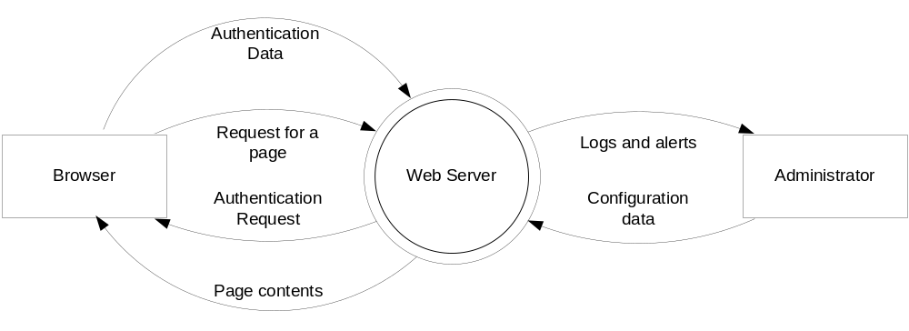

IIS6 Context Diagram

Slide 30
Identifying Subsystems cont’d
Carefully consider all entry points to your application – such as Web pages or socket servers – as these are potential routes for attack. Also consider entry points on internal subsystems or components. Although these entry points may only exist to allow internal communication between components in your application, they could also serve as points of attack, if the attacker manages to bypass the normal “front door” security controls.
Consider code that accesses secure resources such as DNS servers, directory services, environment variables, event logs, file systems, message queues, performance counters, printers, the registry, sockets, and Web services. Any code that demands special privileges or which works with the security system (for example .NET code access security) demands special vigilance

Slide 31
Identifying Subsystems contd
Create a security profile for the application by documenting the design and implementation approaches for the application its self, input validation, authentication, authorization, configuration management, and the remaining areas where applications are most susceptible to vulnerabilities.

Slide 32
Threat Modeling Process – Step 4: Identify the Threats
Assemble team
Identify threats
  Network threats
  Host threats
  Application threats

Slide 33
Identify the Threats
In this stage of the threat modeling process, you identify threats to your system assets. The best way to do this is to assemble a team consisting of members of the development and test teams to conduct an informed brainstorming session in front of a whiteboard.

Slide 34
Defining the System in order to identify the threats (Cont’d)
EXTERNAL SECURITY NOTES
What do external entities need to be aware of in the context of security with regards to your application?
  Who depends on your application?
    Can they trust your outbound feed(s)?
    Who do they need to contact re: security?
INTERNAL SECURITY NOTES
Are both host and application based threats.
Document security strategy notes
  Priorities
  Challenges
  Exceptions
  Constraints
IMPLEMENTATION
ASSUMPTIONS
Platform
  W2K vs. W2K3 vs. ???
Technologies
  SQL 2000 vs. ???
Protocols
  SSL vs. IPSec
Standards
  Known mitigating factors from Design Time

Slide 35
Identify the Threats cont’d
There are three types of threats that you need to identify. You need to:
    Identify network threats: Analyze the network topologies and look for vulnerabilities. Ensure your network is not vulnerable to incorrect device and server configuration.
    Identify host threats: Look for vulnerabilities through poor configuration of hosts security. Consider patch levels and updates, services, protocols, accounts, files and directories, shares, ports, and auditing and logging.
    Identify application/algorithm threats: Scrutinize the security profile you created in the previous stage of the threat modeling process. Focus on application threats, technology-specific threats, and code/algorithm threats. Look for things such as poor input validation, passing authentication credentials over unencrypted network connections, or using weak password or account policies.

Slide 36
THREAT MODELLING APPROACHES
Threat modelling is a key element to integrate security into software systems.
It enables us to identify critical areas of design which needs to be protected. Over the time various threat modelling approaches and methodologies have been developed and are being used in the process of designing secure web applications.
This approach varies from conceptual frameworks to practical methodologies. The following paragraphs present a brief survey of existing threat modelling methodologies and techniques.

Slide 37
1. Stride
STRIDE is most widely used threat model. STRIDE covers the main six broad categories of threats. These threat categories include Spoofing, Tampering, Repudiation, Information Disclosure, Denial of Service, and Elevation of Privilege [6].
In this model, a data flow diagram of the system under consideration is developed and STRIDE model is applied at each node of this Data Flow Diagram of the system. Then security threats are identified manually and listed.

Slide 38
1. Stride cont’d
After this STRIDE model, another model called DREAD model is applied to each identified. The DREAD model is a threat rating model and is used to assign threat severity and priority level of identified threats. The DREAD model stands for Damage potential, Reproducibility, Exploitability, Affected users and Discoverability.
When this process of threat rating by the DREAD model is completed, possible mitigation measures are recommended and listed in the next chapter
STRIDE approach is a manual process and does not have tool support.

Slide 39
Threat Modeling Process – Identify the Threats by Using STRIDE
Types of threats | Examples
Spoofing | Forging e-mail messages Replaying authentication packets
Tampering | Altering data during transmission Changing data in files
Repudiation | Deleting a critical file and deny it Purchasing a product and deny it
Information disclosure | Exposing information in error messages Exposing code on Web sites
Denial of service | Flooding a network with SYN packets Flooding a network with forged ICMP(Internet Control Message Protocol)packets
Elevation of privilege | Exploiting buffer overruns to gain system privileges Obtaining administrator privileges illegitimately

Slide 40
Terminology Example
Asset(s):
  $5,000,000 under the mattress in guest bedroom
Threat(s):
  Loosing the $5,000,000
Entry/Exit Points:
  Front & Side Doors
  Windows (guest bedroom & elsewhere in residence
Note vulnerability can be shared across various attacks surfaces(!)
Threat | Attack | Vulnerability | Risk (0-100)
Loosing the $5,000,000 | Burglar breaks in and steals money | Plane glass windows | 95
 |  | Windows can be lifted out of frame | 85
 |  | No dead bolt on doors / doors can be kicked in | 75
 |  | No alarm system | 100
 | House Burns Down | No alarm system | 100

Slide 41
Identify the Threats by Using STRIDE cont’d
Categorizing the threats that hackers pose has many benefits. For example, by categorizing the threats,
  you can identify and develop security policies that apply to a range of threats in a category and not just to individual threats.
The STRIDE categories are:
  Spoofing – Illegally accessing and then using another user’s authentication information, such as user name and password. For example, a hacker can bypass authorization by using SQL injection and assuming the “sa” role.
  Tampering with Data – Maliciously modifying data. An example would be making unauthorized changes to persistent data such as data in a database or alternating data as it flows between two computers over an open network, such as the Internet or the data that sits on a host
  .

Slide 42
Identify the Threats by Using STRIDE cont’d
  Repudiation–Threats associated with users denying (repudiating) an action when other parties do not have any way of proving otherwise.
  Information disclosure – Exposing information to unauthorized individuals. An example would be reading data in transit between two companies. Another example is using cross-site scripting to steal somebody’s cookies.
  Denial of service – Denying service to valid users. An example would be making a Web server temporary unavailable or unusable. Another example is exploiting a buffer overrun that causes a server to restart.
  Elevation of privilege – An unprivileged user gaining privileged access and thereby having sufficient access to compromise or destroy the entire system. An example would be exploiting a buffer overrun to gain a command shell and adding the hacker to the Administrators group.

Slide 43
For each threat…
What are the conditions that allow the threat to take place (THREAT TREES)
What are the attacks?
  How would you classify the attack (STRIDE)
  What are the ENTRY / EXIT Points?
  What protected resources / assets are exposed?
  Enumerate vulnerabilities that allow the attack
  Evaluate RISK before mitigation…
  …evaluate risk after mitigation
  …how would you verify / test the mitigation?

Slide 44
Threat Modeling Process – Identify the Threats by Using Attack Trees
What are the conditions that allow the threat to take place (THREAT TREES)
Building threat trees is an effective method for determining computer system security issues. The idea behind threat trees is that an application is composed of threat targets and that each target could have vulnerabilities that when successfully attacked could compromise the system.
The threat tree describes the decision-making process an attacker would go through to compromise the software component.
The decomposition process has helped you to identify all the system components. You then identify potential threats to each component. Threat trees then help you decide how that threat could manifest itself.

Slide 45
Threat Modeling Process – Identify the Threats by Using Attack Trees
The way to write a threat tree is to identify goals and sub-goals of an attack, as well as what must be done so that the attack succeeds.
The threat tree on this slide shows the ways in which an attacker could view another user’s confidential payroll data.
Although threat trees communicate data well, they can become cumbersome when building large threat models. An alternative way of representing the threat tree is using an outline, as illustrated on the slide.

Slide 46
Attack tress cont’d
An attack tree and a threat tree are the same thing. In a traditional application threat model, you start with the component that you're building, (be that the entire application, a component or function, a data flow, etc.) and enumerate the potential threats to that component.
When you're building an attack tree, the development is reversed. You start with the attacker's end goal, and then enumerate the possible ways you could achieve the end goal, and only then look at the application to find locations where it may be vulnerable to the vectors you've identified.
Ideologically, attack trees are more a red-team style attacker-centric approach to the problem, which can provide useful additional insight.
Attack trees are conceptual diagrams showing how an asset, or target, might be attacked. Attack trees have been used in a variety of applications. In the field of information technology, they have been used to describe threats on computer system and possible attacks to realize those threats. However, their use is not restricted to the analysis of conventional information systems. They are widely used in the fields of defense and aerospace for the analysis of threats against tamper resistant electronics systems (e.g., avionics on military aircraft).^{[1]} Attack trees are increasingly being applied to computer control systems (especially relating to the electric power grid ).^{[2]} Attack trees have also been used to understand threats to physical systems.

Slide 47
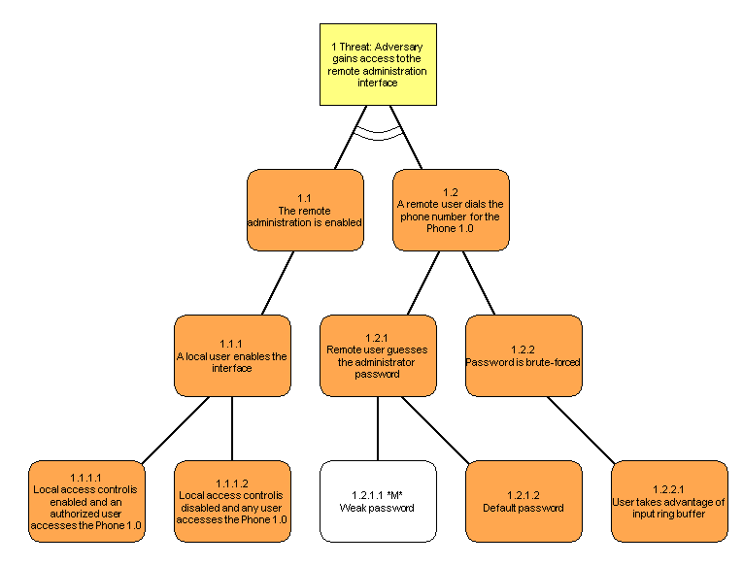
Threat Trees

Slide 48
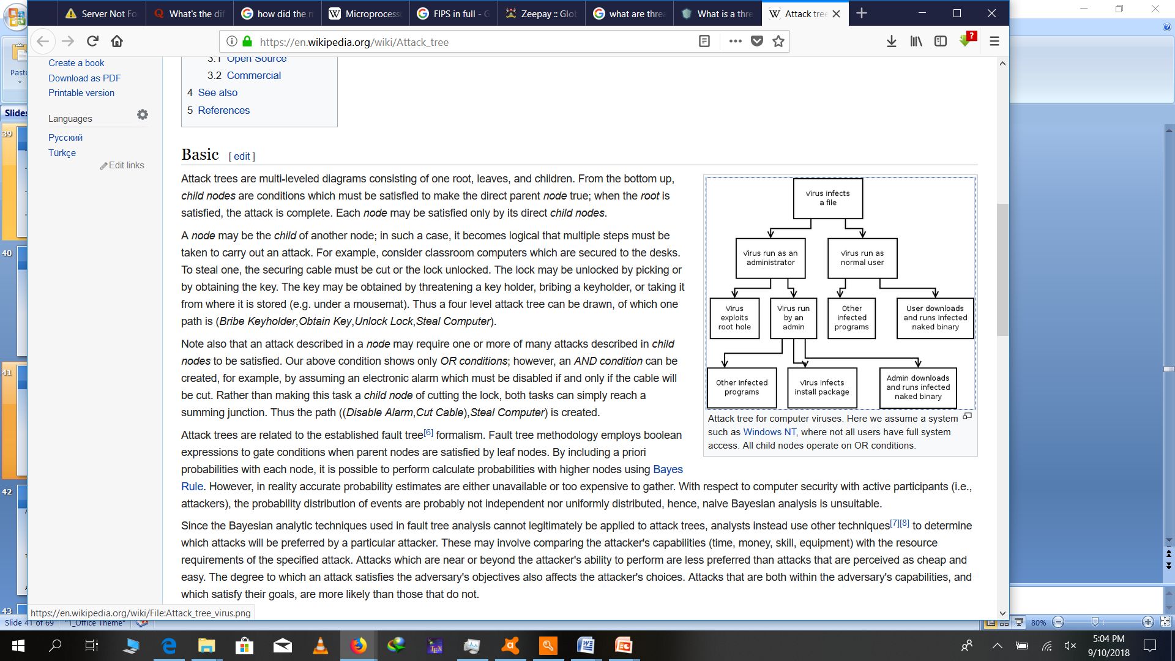

Slide 49
Attack surfaces
Attack surface: the reachable and exploitable vulnerabilities in a system
  Open ports
  Services outside a firewall
  An employee with access to sensitive info
  …
Three categories
  Network attack surface (i.e., network vulnerability)
  Software attack surface (i.e., software vulnerabilities)
  Human attack surface (e.g., social engineering)
Attack analysis: assessing the scale and severity of threats

Slide 50
Attack trees
A branching, hierarchical data structure that represents a set of potential vulnerabilities
Objective: to effectively exploit the info available on attack patterns
  published on CERT or similar forums
  Security analysts can use the tree to guide design and strengthen coiuntermeasures

Slide 51
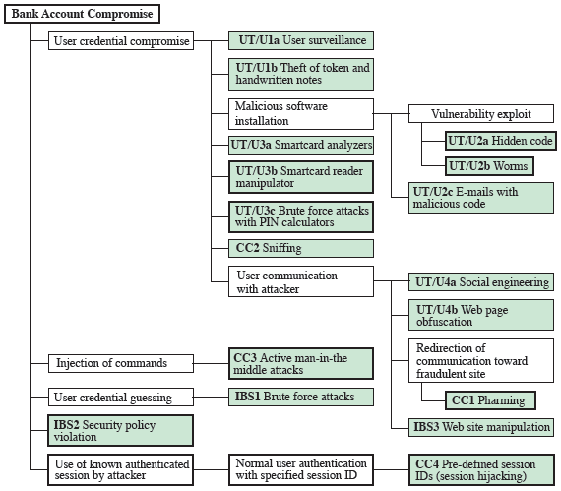
An attack tree

Slide 52
Threat Modeling Process – Identify the Threats by Using Attack Trees
1.0 View payroll data (I)
1.1 Traffic is unprotected (AND)
1.2 Attacker views traffic
1.2.1 Sniff traffic with protocol analyzer
1.2.2 Listen to router traffic
1.2.2.1 Router is unpatched (AND)
1.2.2.2 Compromise router
1.2.2.3 Guess router password
Threat #1 (I)
View payroll data
1.1
Traffic is
unprotected
1.2
Attacker views
traffic
1.2.1
Sniff traffic with
protocol analyzer
1.2.2
Listen to router
traffic
1.2.2.1
Router is
unpatched
1.2.2.2
Compromise
router
1.2.2.3
Guess router
password

Slide 53
Threat Modeling Process – Step 5: Document the Threats
Document threats by using a template:
Leave Risk blank (for now)
Threat Description | Injection of SQL Commands
Threat target | Data Access Component
Risk
Attack techniques | Attacker appends SQL commands to user name, which is used to form a SQL query
Countermeasures | Use a regular expression to validate the user name, and use a stored procedure with parameters to access the database

Slide 54
Document all the threats you identify.
You must include the threat target and threat description. The Risk is left blank for now, and is completed in the final stage of the process.
You may want to include the attack techniques, which can also highlight the vulnerabilities exploited, and the countermeasures that are required to address the threat.

Slide 55
Threat Modeling Process – Step 6: Rate/measure the Threats
Use formula:
  Risk = Probability * Damage Potential
Use DREAD to rate threats
  Damage potential
  Reproducibility
  Exploitability
  Affected users
  Discoverability

Slide 56
Rate the Threats cont’d
At this step, you can fill in the risk data that you left blank in step 5.
After you document your threats, you need a way to determine which threats are the most dangerous. To do this, you need a way to rank them.
You can calculate risk using a 1-10 scale for probability (where 1 is not probable, 10 is very probable), and 1-10 for damage potential (1 – minimal damage, 10 – catastrophe). This results in a risk in the range of 1 – 100. You can divide the scale into three bands to generate a High, Medium and Low risk rating.

Slide 57
Rate the Threats cont’d
This way of assessing risk is too simplistic for some, so at Microsoft, the DREAD model is used to refine this calculation to add a dimension that assesses what the impact of a security threat really means.
  Damage potential: How much damage can the threat inflict on the system?
  Reproducibility: How difficult is it to reproduce the threat?
  Exploitability: How easy is it for hackers to succeed in exploiting a vulnerability?
  Affected users: How many users will be affected?
  Discoverability: How difficult is it to discover the threat?

Slide 58
Rate the Threats cont’d
Applications and companies use different criteria for different elements of the DREAD model. The formula used to calculate the rank is not as important because the values derived are relative to one another. You just need to be consistent.
DREAD provides a further refinement of the simple
Risk = Damage * Chance formula.
  D (Damage Potential) and A (Affected users) are analogous to Damage.
  R (Reproducibility), E (Exploitability) and D (Discoverability) are analogous to Chance.
You can use this strategy to prioritize risks. After you calculate the priority for each identified security risk, you can prioritize the risks and determine a management strategy based on the priority value.
Within each DREAD category, use a score of 3 for high risk, 2 for medium risk, and 1 for low risk.

Slide 59
Rate the Threats cont’d
Assess each threat in your threat tree and assign the risk rating for each of the DREAD categories and add up the result.
For example, the SQL Injection threat identified earlier could have a score of D – 3, R – 3, E – 3 , A – 3, D – 2. This gives a total score of 14.
Across the total possible range of 5 – 15, 12 – 15 may be considered high risk, 8 – 11 as medium risk, and 5 – 7 as low risk.

Slide 60
Calculation of Risk
(How does DREAD do this?)
Risk = Impact * Probability
Impact = (DREAD)
  Damage
    Note that Damage needs to be assessed in terms of Confidentiality, Integrity and Availability
  Affected Users (how large is the user base affected?
Probability = (DREAD)
  Reproducibility (how difficult to reproduce? Is it scriptable?)
  Exploitability (how difficult to use the vulnerability to effect the attack?)
  Discoverability (how difficult to find?)

Slide 61
Calculation of Risk (Cont’d)
Let’s establish a few assumptions
  In the Risk equation; Damage and Probability are equally important
  The factors, as well as the result should have mathematical value (in order to assist in easily determining priorities)
  Therefore in any formula giving each factor equal weight an imbalance occurs giving Probability a 3:2 representation over Damage
To mitigate:
    e.g. Risk = Impact(D+A) * Probability(R+E+D)
    while ensuring the summary of qualitative scales for Risk and Probability are equal (e.g. D+A=(1-10) & R+E+D=(1-10) which results in a scale of 6-100 when the summation of factors are multiplied

Slide 62
Damage
Damage has 3 categories and each has been given it’s own value ranking
  Confidentiality (Read)
    Vulnerability or exposure of sensitive data or process (e.g. application or business logic)
  Integrity (Write)
    Compromise of application or system data integrity (e.g. log tampering, data modification)
  Availability
    Degradation or denial of service

Slide 63
Damage
 | Confidentiality (Read) | Integrity (Write) | Availability (access)
5 – Critical | Data Elements* -SSN, CreditCard, Passwords | Data Elements -SSN, CreditCard, Bank Account # | Domain Control:
4 – High | Data Elements -Bank Acct #, - (as defined} | Data Elements -(as defined} | Moderate Host Control:
3 – Moderate | Data Elements -(as defined} | Data Elements -(as defined} | Partial Denial:
2 – Minor | Data Elements -(as defined} | Data Elements -(as defined} | Degradation
1 – Trivial | Data Elements -(as defined} | Data Elements -(as defined} | Nuisance:

Slide 64
Affected Users
 | Roles (Confidentiality, Integrity) | Population (Availability)
5 | Admin | All
4 | Power Users | Most
3 | Group | Many
2 | User | Few
1 | Public | None

Slide 65
Reproducibility
Value | Description
1 - Complex | The attack is very difficult to reproduce, even with knowledge of the security hole
2 - Moderate | The attack can be reproduced, but only with a timing window and a particular race situation
3 – Simple | The attack can be reproduced every time and does not require a timing window

Slide 66
Exploitability
Value | Description
1-Expert | The exploit is unpublished, difficult to execute and requires significant insider knowledge and technical expertise or multiple vulnerabilities must be exploited before any impact can be realized.
2-Journeyman | The exploit is unpublished, difficult to execute and requires significant insider knowledge or technical expertise.
3-Adept | The exploit is known (including technical and/or insider information) but is difficult to execute and no exploit code is available.
4-Novice | The exploit is well known and automated script has been provided that script-kiddies can run to exploit the vulnerability.

Slide 67
Discoverability
Value | Description
1-Difficult | The vulnerability is obscure, and it is unlikely that users will work out damage potential
2-Moderate | The vulnerability is in a seldom-used part of the product, and only a few users should come across it. It would take some thinking to see malicious use
3-Easy | Published information explains the attack. The vulnerability is found in commonly used features and is very noticeable

Slide 68
Therat modelling finally
Use DREAD to calculate
  The risk before mitigation
  The risk after mitigation
  The cost of implementing the mitigation AND the cost to maintain the mitigation
    NOW you can make an accurate assessment of the best mitigation for a given vulnerability!!!
Example: Using SSL or IPSec to secure IIS – SQL Server
  SSL: Low cost to turn on, but can easily be turned off (what is the cost to validate the mitigation over time?
  IPSec: High cost to turn on initially, but low maintenance cost + INCREASED SECURITY
    Perf impact on both machines, but Accelerator cards can easily mitigate this

Slide 69
Threat Modeling Process – Example: Rate the Threats
Damage potential
Affected Users
-or-
Damage
Threat #1 (I)
View payroll data
1.1
Traffic is
unprotected
1.2
Attacker views
traffic
Reproducibility
Exploitability
Discoverability
-or-
Chance
1.2.1
Sniff traffic with
protocol analyzer
1.2.2
Listen to router
traffic
1.2.2.1
Router is
unpatched
1.2.2.2
Compromise
router
1.2.2.3
Guess router
password

Slide 70
In summary, threat modeling is a valuable analysis tool which improves the design process. It allows you to identify the most vulnerable parts of your application so you can focus your efforts on those places. It also helps you to identify appropriate techniques for mitigating threats.
The benefit of threat modeling does not end there. Use threat modeling through the coding process to revisit and retest security decisions made in the design phase and to direct focus in security code reviews.
The results of the threat modeling process provide the information necessary to select appropriate security technologies and techniques to mitigate the threats that have been identified.
Data flow diagrams are an effective tool for identifying data flows and are particularly useful for identifying all inputs to your application. Any inputs are a particular source of security vulnerabilities.

Slide 71
Coding to a Threat Model
Use threat modeling to help
  Determine the most “dangerous” portions of your application
  Prioritize security push efforts
  Prioritize ongoing code reviews
  Determine the threat mitigation techniques to employ
  Determine data flow

Slide 72
Risk Mitigation
Secure Development Process
Threat Modeling
Risk Mitigation
Security Best Practices

Slide 73
As mentioned, the assets of a computer system can be categorized as hardware, software, data, and communication lines and networks. We briefly describe these four categories and relate these to the concepts of integrity, confidentiality, and availability, as illustrated here in Figure 1.3.
Hardware - A major threat = is the threat to availability. Hardware is the most vulnerable to attack and the least susceptible to automated controls. Threats include accidental and deliberate damage to equipment as well as theft. Theft of CDROMs and DVDs can lead to loss of confidentiality. Physical and administrative security measures are needed to deal with these threats.

Slide 74
Software - includes the operating system, utilities, and application programs. A key threat is an attack on availability. Software is often easy to delete. Software can also be altered or damaged to render it useless. Careful software configuration management can maintain high availability. A more difficult problem is software modification (e.g. from virus/worm) that results in a program that still functions but that behaves differently than before, which is a threat to integrity/authenticity.
Data - involves files and other forms of data controlled by individuals, groups, and business organizations. Security concerns with respect to data are broad, encompassing availability, secrecy, and integrity. In the case of availability, the concern is with the destruction of data files, which can occur either accidentally or maliciously. The obvious concern with secrecy is the unauthorized reading of data files or databases. A less obvious secrecy threat involves the analysis of data and manifests itself in the use of so-called statistical databases, which provide summary or aggregate information. Finally, data integrity is a major concern in most installations. Modifications to data files can have consequences ranging from minor to disastrous.

